Slide 2
CIA 1
ANSWERS DISCUSSION

Slide 3
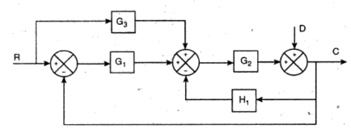
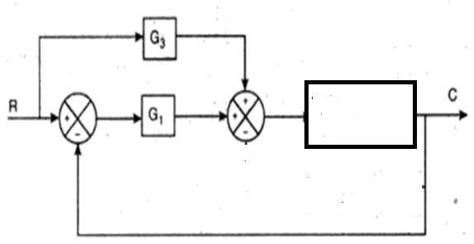
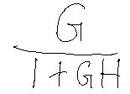

Slide 4
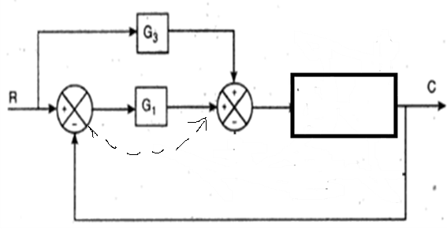

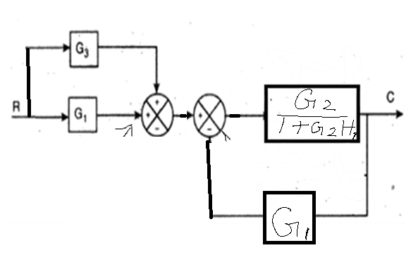
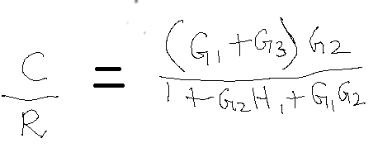

Slide 5



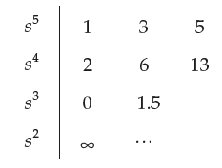

Slide 6


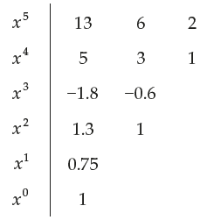
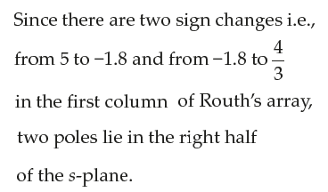
Unstable System

Slide 7
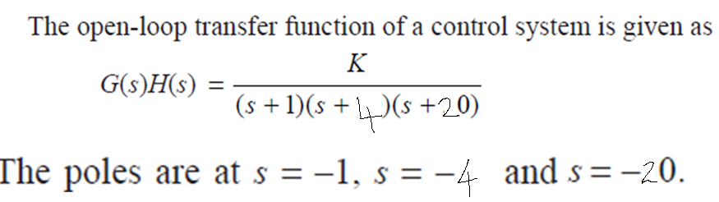
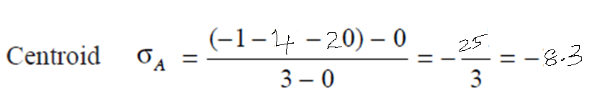

Slide 8
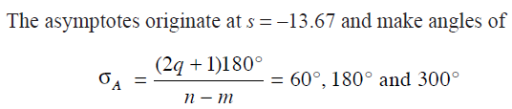
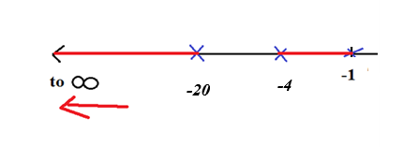
Breakaway point is at -2.43, -14.23
Using Routh, can check for K value & ω values…
K = 2520, ω = ±10.2 i

Slide 9
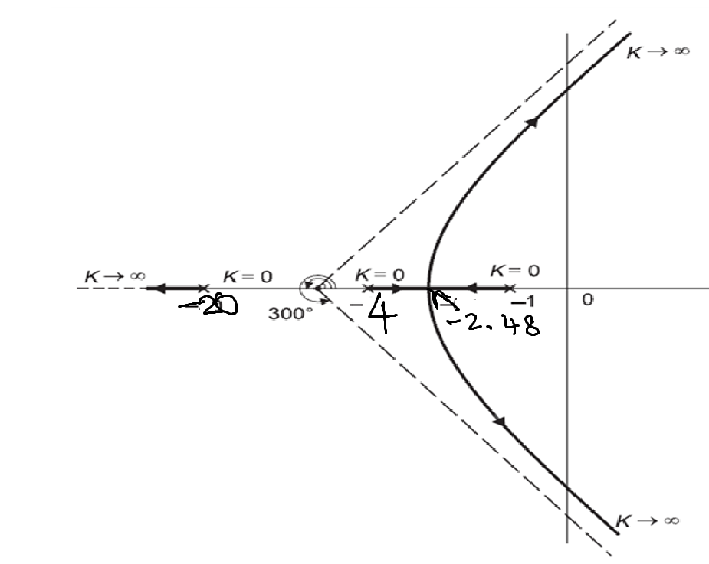

Slide 10

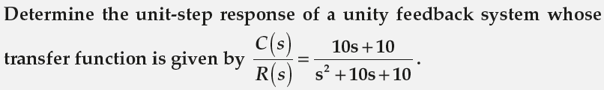
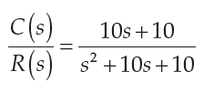



Problems in Time Response Analysis
X 6
X 6

Slide 11



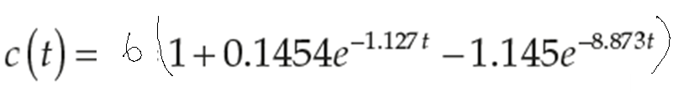
Problems in Time Response Analysis
6

Slide 12
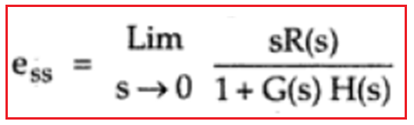
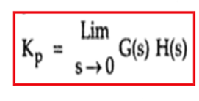
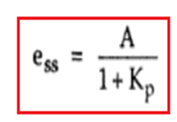
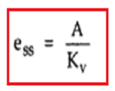
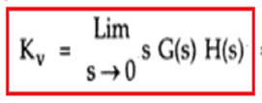
For step input of magnitude 5,
R(s) = 5/s
Kp = (20/6)(5/3) = 5.55
ess = 5/(1+ 5.55) = 0.76
ess = 5/[1 + (20/6)(5/3)] = 0.76
For ramp I/P of magnitude 6, R(s) = 6/ s²
Kv = 0 ; ess = infinity

Slide 13
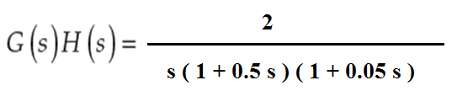

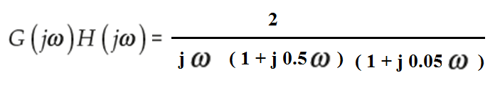
BODE

Slide 14




Problems in Bode Plot

Slide 15


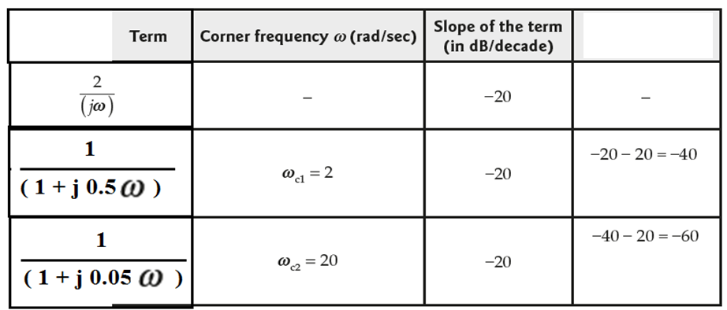
Problems in Bode Plot
Change
in slope
-20 slope
up to 2
( b/w 2 to 20)
slope is -40 db/dec
( b/w 20 to infinity
slope is -60 db/dec

Slide 16

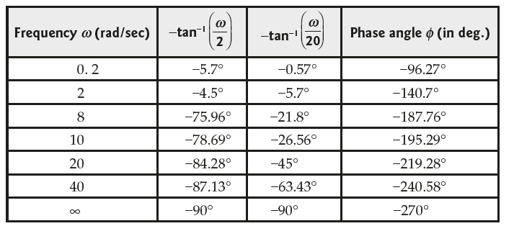

Slide 17


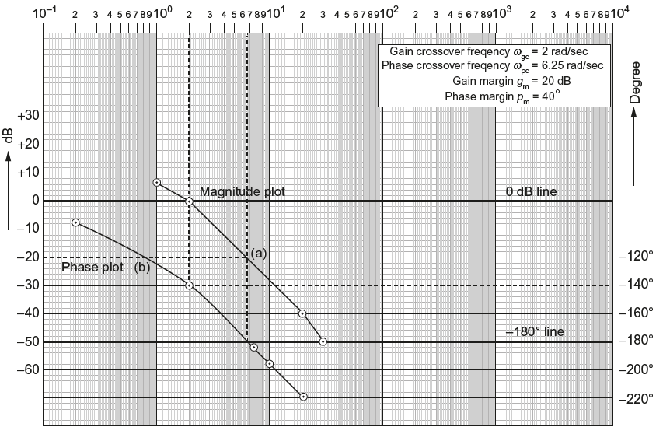
To find the starting point by considering the lowest value of ω as either 0.1 or as 1
-20 dB/dec
-40 dB/dec
-60 dB/dec

Slide 18
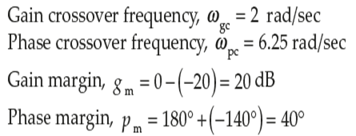
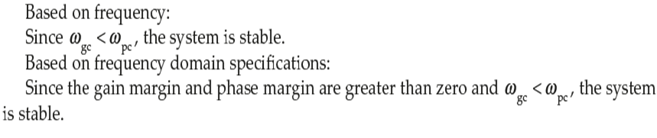
GM = 19 dB at 5.66 r/s (i.e.ωpc )
PM = 46° at 1.57 r/s (i.e.ωgc )

Slide 19
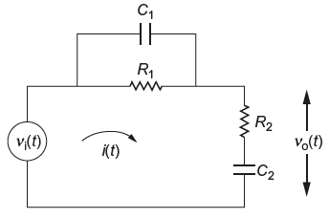
MODEL
V_{o} / V_{i} = (Rcs+1)²/ (R²c²s² + 3 R C s + 1)

Slide 20
THANK YOU

